Slide 1


SmartArch: Being A Successful Solution Architect at CitiusTech
February 2014
This document is confidential and contains proprietary information, including trade secrets of CitiusTech. Neither the document nor any of the information contained in it may be reproduced or disclosed to any unauthorized person under any circumstances without the express written permission of CitiusTech.

Slide 2
Agenda
SmartArch Program Background
SmartArch: Leadership
Solution Architect: Overall Role & KRAs
Solution Architect: Key focus areas
Client Success
Team Success
Business Growth
Personal Growth
SmartArch Assignment

Slide 3
CitiusEdge: Program Objective
SmartArch Objectives:
Groom Tech leads at CitiusTech to play the role of a Solution Architect and develop overall delivery excellence
Training led by senior CitiusTech Solution Architects/ managers
Important Side Objectives:
Develop and standardize best practices across the organization –execute projects in “CitiusTech-way”
Create opportunity for participants to engage between themselves and with instructors

Slide 4
Agenda
SmartArch Program Background
SmartArch: Leadership
Solution Architect: Overall Role & KRAs
Solution Architect: Key focus areas
Client Success
Team Success
Business Growth
Personal Growth
SmartArch Assignment

Slide 5
Focus of Today’s Session
This session is about some thoughts on …
Managing multiple stakeholders and key success factors
Prioritizing overall plans and activities
Using simple tools / templates which work well for me
Building a great team around you
Addressing areas which you may find challenging

Slide 6

Summary: Jack Welch Video
Need to verify if the video makes sense
Jack Welch
Legendary CEO of General Electric (GE)
#1 Management Guru
Jack Welch Video on Leadership
Describes the key role of a leader – building and creating a high powered team
Talks about the shift from “I” to “them” when you become a leader
Play Video

Slide 7
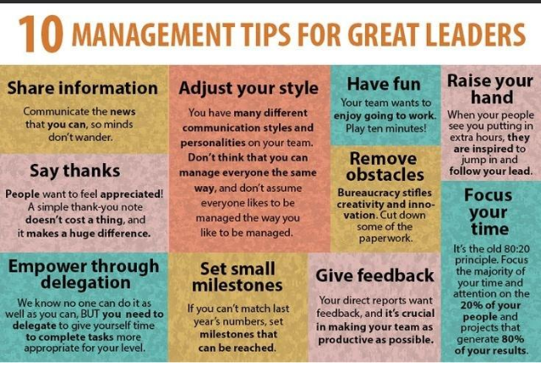
Leadership Tips

Slide 8
Agenda
SmartArch Program Background
SmartArch: Leadership
Solution Architect: Overall Role & KRAs
Solution Architect: Key focus areas
Client Success
Team Success
Business Growth
Personal Growth
SmartArch Assignment

Slide 9
Solution Architect: Key Result Areas (KRAs)
High Client Satisfaction
Excellent client relationship – Engage with the architects and other stakeholders at the client side to provide “consultative’’ advice on what we should be doing differently
Mutual respect and trust
Exceptional project execution
High quality of project delivery - provide deep domain and technical expertise in planning, architecting and constructing enterprise class software applications
Timeliness of project delivery
High Team Satisfaction
Growth and development of team members
Collaborative and fun team working / environment
Revenue growth / new business opportunities for CitiusTech
Within existing Client
Support sales process with similar healthcare organizations
While a Solution Architect’s primarily role is to play a technical liaison between the client and the team, it is also required for the individual to play a leadership role and support project management functions to ensure that we are using the right tools and processes to deliver high quality output

Slide 10
Client Management: Delivery Focus (1/6)
Area | Coverage | Key Participants | Communication Tools
Project Kick-off | Launch project Finalize key deliverable Finalize approach | CT – TBD Streamline Health team | Common knowledge repository for process assets, guidelines and reference implementations Threaded bulletin board for team interaction Telephone number / conferencing Project Lead – Blackberry email / phone access Secure email for all team members In-person meeting at Streamline Health onsite
Daily call (15-30 min.) | Daily Scrum updates - plan / activity review | CT – Full team Streamline Health - Project Manager
Weekly - Project Management | Weekly Dashboard Task completion Deliverable Quality Issue Management and resolution | CT – Project Lead Streamline Health - Project Manager
Monthly / Quarterly - Relationship Management Review | Monthly Progress Plan v/s actual Reports: Resources, Schedule Project scope changes Overall project feedback | CT – Project Lead, SVP - Technology, CEO (as needed) Streamline Health – TBD

Slide 11
Client Management: Delivery Focus (2/6)
Project Kick-off
When | Why | Guidelines
Starting relationship with new customers Starting new initiative with existing customer Starting new project for current initiative | Increase customer’s confidence in our ability to execute Set expectations – timelines, roles & responsibilities, dependencies Communicate Short-term plan and Immediate Needs to get off to a strong start Ensure that we have “APPLIED” ourselves so that we are set-up for success | Establish credibility – to ensure you are heard Prepare well – to understand client and project context Be real – in preparing the plan Seek help – for areas where you are not confident Be prescriptive – in defining short-term plan

Slide 12
Client Management: Delivery Focus (3/6)
Daily Call
When | Why | Guidelines
If client insists ☺ New project/ initiative When you are reaching critical milestones When email/ messenger is not working When you pick-up “dis-satisfaction” in customer’s “tone” | Ensure dramatic in increase in communication during critical phases of the project To stop playing tennis and start playing football Resolve blocking issues | Prepare well – meet with the team at least an hour before the call Summarize – take control by summarizing progress and items for discussions Go through the list – quickly Wrap-up early – with clear action items
CT Internal

Slide 13
Client Management: Delivery Focus (4/6)
Weekly Dashboard
When | Why | Guidelines
Weekly ☺ - for EACH INDEPENDENT INITIATIVE | Increase transparency – on progress and issues Reduce surprises – by clearly identifying issues on weekly basis Identify bottlenecks and seek help | Prepare well – this should be the first activity that you do on the day of the dashboard Be crisp and direct – avoid too much details in dashboard document Finish the call in 30 minutes – with clear articulation of decisions and next steps
CT Internal

Slide 14
Client Management: Delivery Focus (5/6)
Monthly review
When | Why | Guidelines
Monthly ☺ - for each unique “customer” | Increase customer confidence at Senior Management level Share progress at Milestone level and clearly identify SCHEDULE/ QUALITY risk Communicate both GOOD NEWS and BAD NEWS Step back and reflect – on what is working well and areas of focus | Prepare well – it typically takes us 2 working days and 5 iterations to get this right Use this opportunity to review go forward plan – and make changes – as appropriate Be candid – internally and with customer and ensure healthy dialogue Involve team members in preparation / actual meeting

Slide 15
Client Management: Delivery Focus (6/6)
Quarterly review
When | Why | Guidelines
Quarterly ☺ - for each unique “customer” | Increase customer confidence at Senior Management level Share progress at Milestone level and clearly identify SCHEDULE/ QUALITY risk Communicate both GOOD NEWS and BAD NEWS Step back and reflect – on what is working well and areas of focus Identify additional opportunities for account growth | Prepare well – it typically takes us 5 working days and 9 iterations to get this right Ensure DL/ ADL or You are doing this meeting in-person! Use this opportunity to review go forward plan – and make changes – as appropriate Be candid – internally and with customer and ensure healthy dialogue Involve team members in preparation / actual meeting

Slide 16
Agenda
SmartArch Program Background
SmartArch: Leadership
Solution Architect: Overall Role & KRAs
Solution Architect: Key focus areas
Client Success
Team Success
Business Growth
Personal Growth
SmartArch Assignment

Slide 17

Overall Leadership Framework
Client Success
Team Success
High quality, on-time delivery
Customer empathy and Responsiveness
Detailed Understanding of clients’ business / technology needs
Strong relationship with client
Team management - clear roles, and goals
Team motivation
People Development
Fairness and consistency in working with team members
Personal Growth
Business Growth
Being a “Thought Leader” not just an implementer
Marketing your skills and capabilities
Setting the bar - “Walking the talk”
“Making it happen”
Capabilities building - delivery
Capabilities building - marketing
Identification of new business/ growth opportunities
Networking / building relationships

Slide 18
CitiusTech: How do we Build & Grow Partnerships
Build long-term partnership approach (e.g., joint planning, architecture)
Do additional work for client (POCs, code analysis, automation, etc.) + demonstrate ability to innovate and propose best practices, tools and technologies
Life is happy!
Expand relationship + Build client’s trust that we can consistently generate high quality deliverables
Successfully execute first project - use the right tools and processes, focus on Quality
Month
1-6
Month
7-12
Year 2
Year 3
Year 4

Slide 19
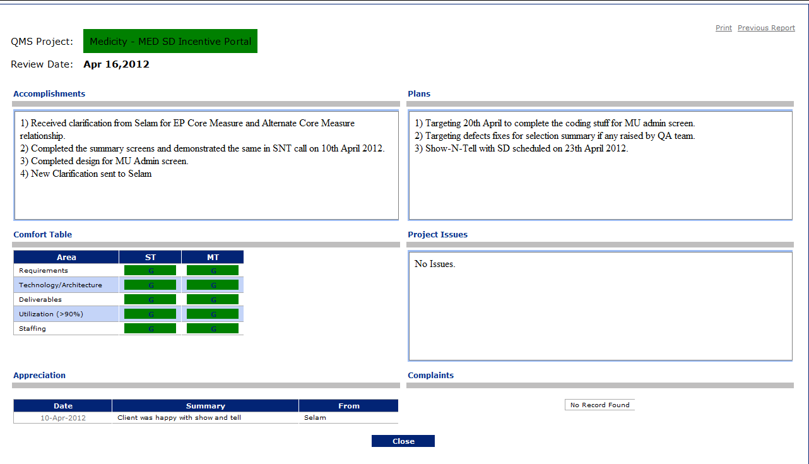
Team Success: A&P… Simple Yet Powerful
Client Success
Team Success
Managing Self
Business & Personal Growth
Weekly / Fortnightly A&P Process
Spend 30 minutes each week / fortnight with each team member
Take a holistic view – client work, personal development, fun
A&P is NOT a performance appraisal – so conduct it in a friendly manner … else everyone will put the “minimal” plans
The “Issues” section is the KEY … puts the responsibility of identifying and discussing issues on each of the team members
A&P Meetings – Core to EVERYTHING we do at CitiusTech

Slide 20
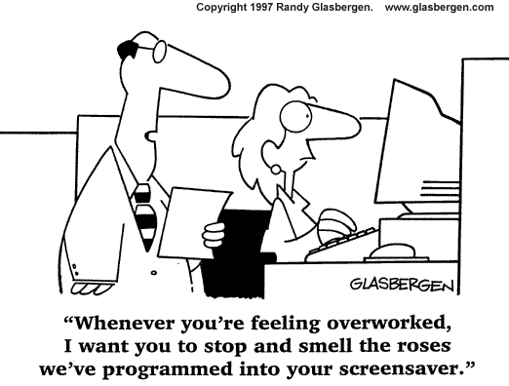
Team Success: Team Management
Client Success
Team Success
Managing Self
Business & Personal Growth

Slide 21
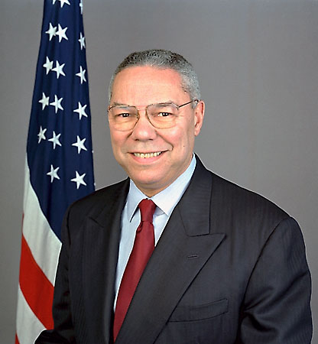
Leadership: Collin Powell Video
Need to verify video and confirm if it is required
Collin Powell
United States Secretary of State (2001–2005)
Commander of the U.S. Army Forces Command (1989) and as Chairman of the Joint Chiefs of Staff (1989–1993)
One of the highest regarded leader in the US today
Collin Powell Video on Leadership
Describes how a leader should conduct himself/ herself to be successful
Similarity of being a leader – irrespective of the role that you are in
Play Video

Slide 22
Team Success: People Development
Client Success
Team Success
Managing Self
Business & Personal Growth
Team Success | Focus for Project Lead
Personal Rapport | Know each team member personally (e.g., family background, previous work experience, interests, hobbies etc.)
Make individuals champions | Identify 1-2 strength areas for each team member (either in work or outside work) Create specific opportunities for each team member to increase his/her profile e.g., conduct training, write a CPD/knowledge pill, lead a Show & Tell session
Create opportunities to learn | Clearly identify 2-3 development needs and give low risk opportunities for development e.g., Communication skills – write documents / emails, lead internal training, present A&P Technical skills – assign mentor, identify training programs Team management - lead internal team meeting / event Give ongoing feedback - and be fair and honest in assessment
If done right, People Development can be the most satisfying part of a PL role

Slide 23
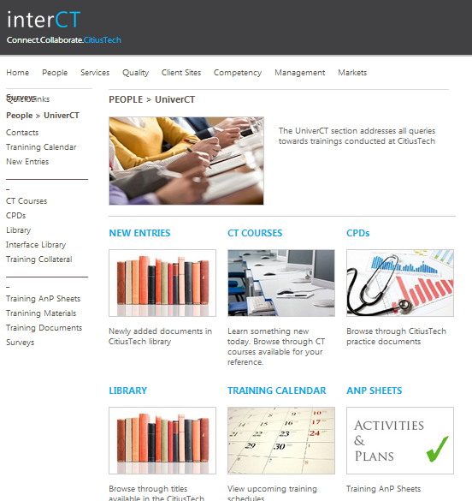
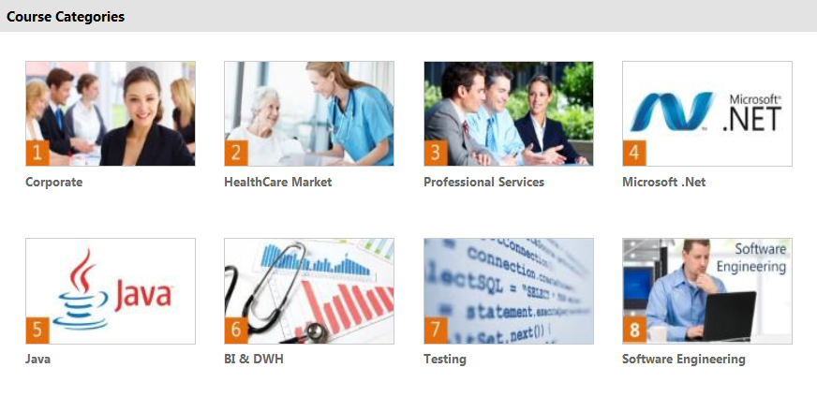
Team Success: Knowledge Development
UniverCT is a comprehensive portal for every employee to access CTCourses, CitiusTech Practice Documents (CPDs), training schedules and has a rich library of books and other resources.
We believe UniverCT is the most comprehensive healthcare technology learning platform in the industry

Slide 24
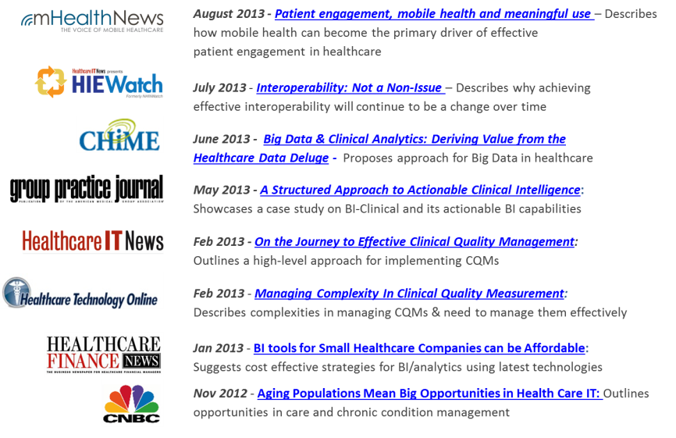
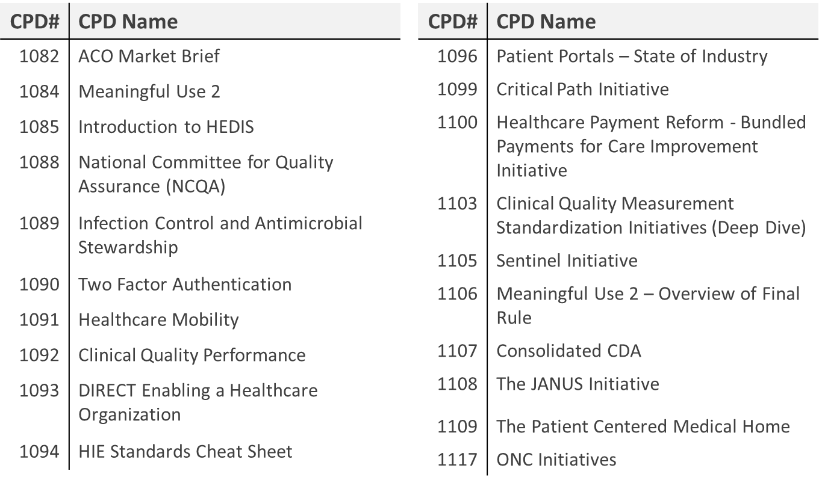
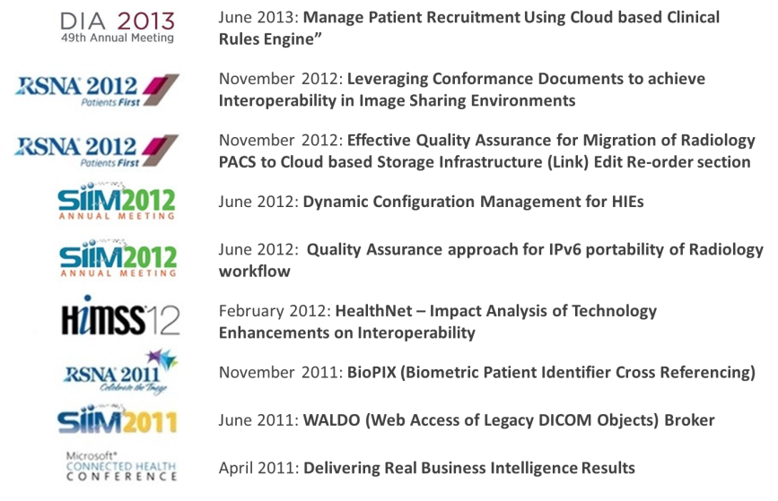
Team Success: Knowledge Sharing (Examples)
Media Coverage
Practice Documents
Research / Publications

Slide 25
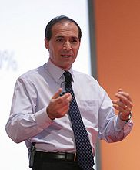
Team Success: Dr. Patrick Dixon Video
Need to verify video and confirm if it is required
Client Success
Team Success
Managing Self
Business & Personal Growth
Dr. Patrick Dixon
Chairman of the trends forecasting company Global Change
Ranked as one of the 20 most influential business thinkers alive according to the Thinkers 50
Author and business consultant
Dr. Patrick Dixon Video on Leadership
Describes the role of leadership and motivation on business growth
Play Video

Slide 26
Overall Leadership Framework
Client Success
Team Success
Personal Growth
Business Growth
Capabilities building - delivery
Capabilities building - marketing
Identification of new business/ growth opportunities
Networking / building relationships

Slide 27
Growth: CitiusTech / Business Perspective
Client Success
Team Success
Managing Self
Business & Personal Growth
Business Growth | Focus for Project Lead
Understand business of customer | Understand key priorities / KRAs for the client team and key client individuals Understand what CitiusTech is doing in some of these areas (for other clients / projects)
Listen to customers | Clients often share their pain areas / concerns on calls, emails, meetings e.g., “We are struggling with questions around technology choices, operational issues like code quality,…….” “What a pain - I was doing interviews all day…” “2 of the key developers are leaving us next week…” “We have a really big backlog and our CEO is putting a log of pressure…” Look out for cues / signs – DONT engage with customers
Work closely with Sales & BD Lead | Communicate simple cues to Sales & BD team Provide value add to the Sales & BD team - Track key competitor organizations / products
Let’s try and play a consultative role for our clients – Tell them our experiences and give suggestions with respect to technology and domain wherever appropriate

Slide 28
Overall Leadership Framework
Client Success
Team Success
Personal Growth
Business Growth
Being a “Thought Leader” not just an implementer
Marketing your skills and capabilities
Setting the bar - “Walking the talk”
“Making it happen”

Slide 29
Growth: Personal Perspective (1/3)
Client Success
Team Success
Managing Self
Business & Personal Growth
How can I differentiate my role at CitiusTech?
What competencies should I build?
How best should I market these capabilities?
Engage with the client in a transparent and forthright manner so that you build the trust and confidence to do new things with them
How will I be perceived as a leader at CitiusTech?
Be known for being “good in something”
Help others - solve their problem, be active on CurioCT
Conduct training sessions
Develop CPDs, white papers etc. along with your team mates!!
Grab opportunity beyond ones role
Key Challenge
Don’t say “Yes” when you want to say “No”
Going outside ones comfort zone
Are you ready to put in the “extra” effort? ☺
Being perceived as a leader is not about getting a promotion – it’s the way we conduct ourselves and the role that we create for ourselves

Slide 30
Growth: Personal Perspective (2/3)
Needs better formatting and a review of the content for these 2 slides by Vinil
Client Success
Team Success
Managing Self
Business & Personal Growth
What competencies should I build?
Analysis – knowledge and use of different analysis and corresponding tools like static code analysis (FxCop, Nitriq, Ndepend, RE-sharper, etc.), cyclomatic analysis, logical line count, etc.
Development tools – Code review (Swarm, Code Striker, etc.), Source Control (GIT, Mercurial, Perforce, SVN, etc.), Unit Testing (Nunit, Junit, Qunit, etc.), Coverage (NCover), Scrum tools (Rally, VersionOne, Jira, etc.), Build tools (MSBuild, TFS, etc.), Deployment automation tools (TeamCity, Jenkins, Hudson, etc.)
How should I use the tools?
Try and understand the nature of the project
Understand what the client is using
Understand licensing requirements for the different tools

Slide 31
Growth: Personal Perspective (3/3)
Client Success
Team Success
Managing Self
Business & Personal Growth
How should I engage with the client
Wherever appropriate, try and share examples of how we execute projects for other clients – Be discrete not to share any sensitive information!
Try and help them with technology decisions – Open Source vs. Licensed tools and technologies – You may want to help them with comparison of tools/ technologies as a value added service
Understand clients infrastructure needs and guide them on areas like load, performance, platforms, servers, etc.
Be aware of different deployment/ licensing strategies and share with the clients – e.g. Cloud vs. on-premise, use of installers, etc.
Note: You may not have the required knowledge of all of the different areas mentioned above. So, feel free to collaborate with other Architects in different projects and share ideas. You may also reach out to the TLG and TLO for more support and consultative advice!!

Slide 32
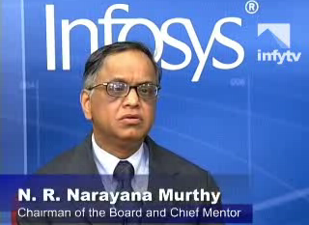
Team Success: Narayana Murthy Video
Client Success
Team Success
Managing Self
Team Success
Check
Business & Personal Growth
Narayana Murthy
Ex-CEO and Chairman of Infosys Technologies
Regarded as a visionary in India for creating a highly successful and value driven organization
Narayana Murthy Video on Leadership
Talk about how leaders play a key role in setting the vision
Describes the need for leaders to leading by example
Play Video

Slide 33
Agenda
SmartArch Program Background
SmartArch: Leadership
Solution Architect: Overall Role & KRAs
Solution Architect: Key focus areas
Client Success
Team Success
Business Growth
Personal Growth
SmartArch Assignment

Slide 34
SmartArch Assignment
Assignment Description | Details / Remark
Topic | Role-play the following scenario: Assume that the client has mentioned about some key initiatives that are starting within their team How will you take those and try to pitch to the client that CitiusTech can help?
Type | Group
Format | Create 2 groups within the attendees – One group will be the client team and the other will be the CitiusTech team You are free to decide the approach to convert the opportunity – calls, documents, presentations, etc.
Expected Time | 10 minutes to discuss strategy 30 minutes to implement it and enact the situation 20 minutes to debirief
Evaluator | Parag S.

Slide 35
Q & A

Slide 36
Thank You

Slide 37
Team Success: Team Management
Client Success
Team Success
Managing Self
Business & Personal Growth
Team Success | Focus for Project Lead
Team member roles & goals | Define high-level roles for each team member (e.g., work, learning, fun) – avoid task level responsibilities Define clear goals & deliverables for all members
Quarterly Plan with Monthly review | Quarterly plans for every team member which is reviewed monthly (6+ monthly plans are too long)
Weekly / Fortnightly A&P | Simple and very useful tool (See next slide) – BED ROCK of everything we do at CitiusTech
1-to-1 sessions | Minimize need for such sessions unless there are personal performance or team interaction issues
Celebrate success / key milestones | Actively find opportunity to celebrate good performance / success … nothing bonds team better!
Having a “rhythm” in the team is key for team members to feel comfortable and be aligned … Quarterly plan > Monthly Review > Weekly A&P

